Slide 1

Movie Ticket Booking
Batch no. : 18
2103A51L34 –(V. Sushma Sri)
2103A51L11 - (G. Manasa)

Slide 2
Objective:
In this project we book ticket using online movie Ticket reservation system. We enter into Web page by logging with User Name and Password. Later you can choose show timings and date you want.The main purpose of our online ticket booking system is to provide an alternate and convenient way for a customer to buy cinema tickets. It is an automatic system.

Slide 3
Elements used in the project
JTextField : The object of a JTextField class is a text component that allows the editing of a single line text. It inherits JTextComponent class.
JLabel : The object of JLabel class is a component for placing text in a container. It is used to display a single line of read only text. The text can be changed by an application but a user cannot edit it directly. It inherits JComponent class.
JButton : The JButton class is used to create a labeled button that has platform independent implementation. The application result in some action when the button is pushed. It inherits AbstractButton class.
JTextArea : The object of a JTextArea class is a multi line region that displays text. It allows the editing of multiple line text. It inherits JTextComponent class.
JPasswordField : The object of a JPasswordField class is a text component specialized for password entry. It allows the editing of a single line of text. It inherits JTextField class.

Slide 4
JCheckBox : The JCheckBox class is used to create a checkbox. It is used to turn an option on (true) or off (false). Clicking on a CheckBox changes its state from "on" to "off" or from "off" to "on ".
JTable : The JTable class is used to display data in tabular form. It is composed of rows and columns.
JScrollBar : The object of JScrollbar class is used to add horizontal and vertical scrollbar. It is an implementation of a scrollbar. It inherits JComponent class.
JOptionPane : The JOptionPane class is used to provide standard dialog boxes such as message dialog box, confirm dialog box and input dialog box. These dialog boxes are used to display information or get input from the user.

Slide 5
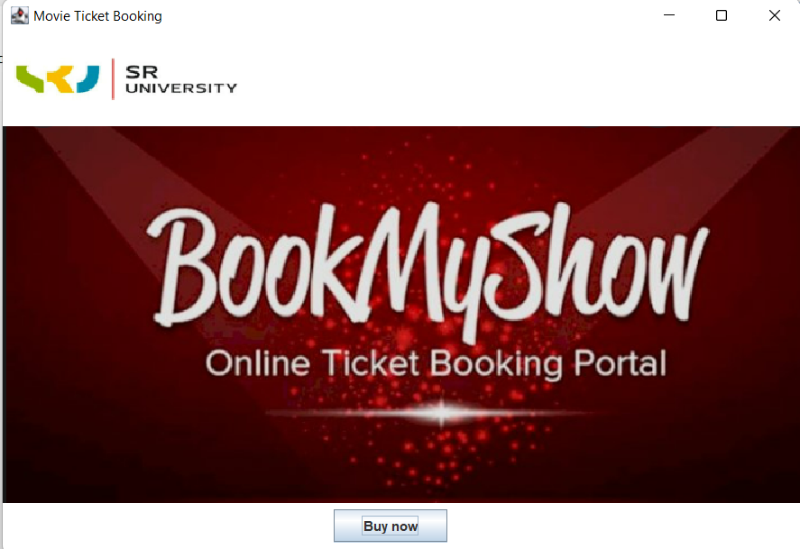

Slide 6
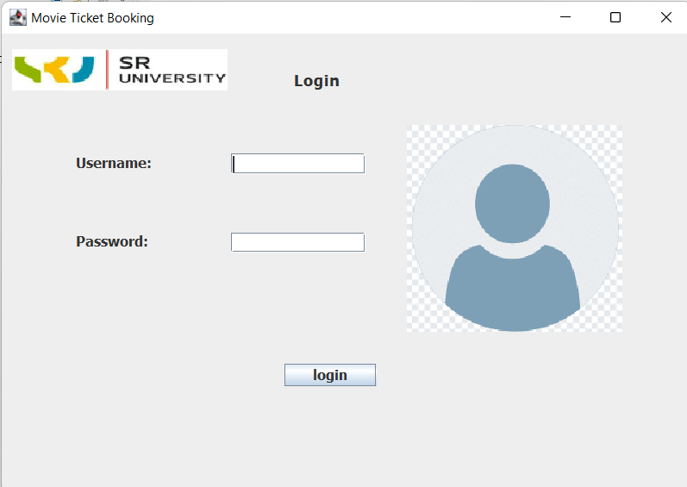

Slide 7
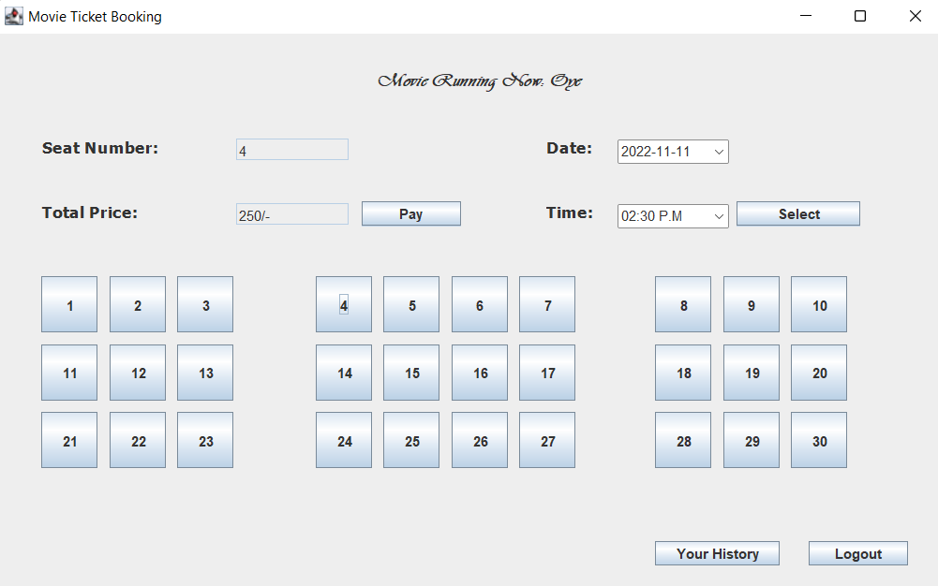

Slide 8
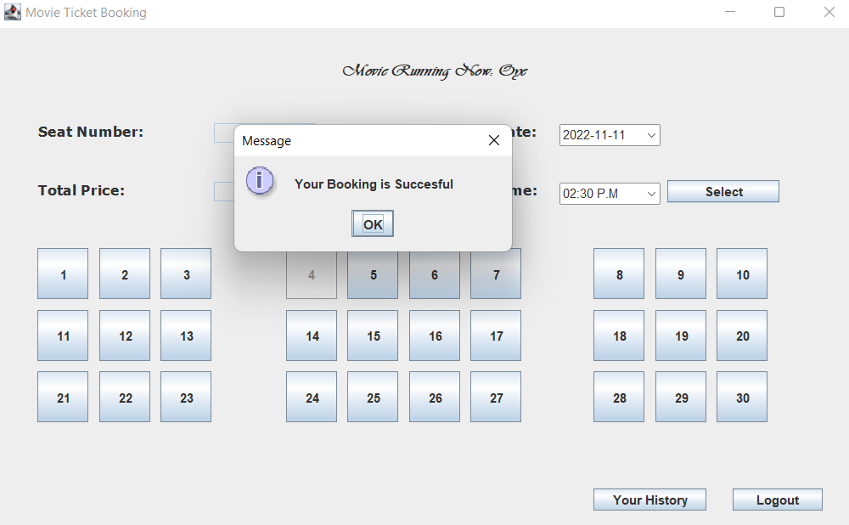

Slide 9
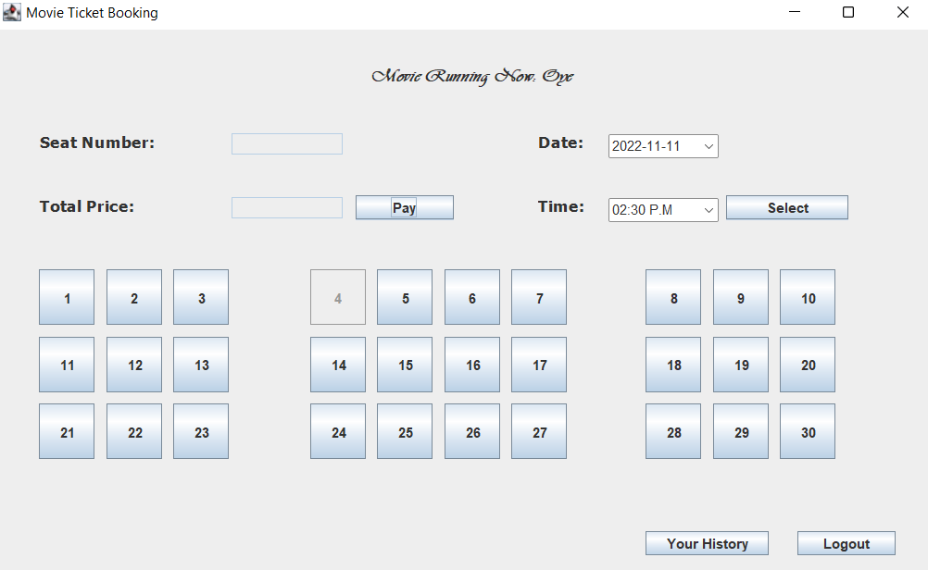

Slide 10
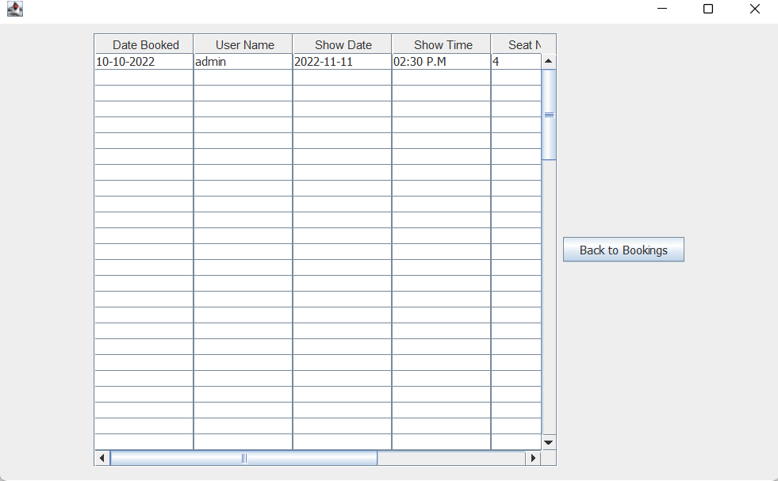
TEST RESULTS

Slide 11
THANK YOU

